Slide 1
The Effect of Credit Availability on Small Business Success
By: James Chiu
Econ 234 – Das
Fall 2009

Slide 2
Table of Contents
Introduction
Literature Review
Data
Conceptual Framework/Model
Technical Analysis
Future Work

Slide 3
Introduction
There are approximately 29.6 million small businesses in the United States, which comprise 99.7% of all employer firms in the country
  (www.score.org)
When attempting to start or run a small business it is necessary to have a large amount of capital in order to finance such an undertaking.
In my research, I hope to find whether there is any correlation between the sources of this capital in relation to the success of the small business.

Slide 4
Literature Review
Berger, Allen N. (1998). The Economics of Small Business Finance: The Roles of Private Equity and Debt Markets in the Finance Growth Cycle. Journal of Banking and Finance, Vol. 22.
Ou, Charles. Williams, Victoria. (2009). Lending to Small Businesses by the Financial Institutions in the United States.
Haynes, George W. Brown, James R. (2009). An Examination of Financial Patterns Using the Survey of Small Business Finances.
Haynes, George W. Brown, James R. (2009). How Strong is the Link Between Internal Finance and Small Firm Growth? Evidence from the Survey of Small Business Finances.
Cole, Rebel A. (2009)Who Needs Credit and Who Gets Credit? Evidence from the Surveys of Small Business Finances.

Slide 5
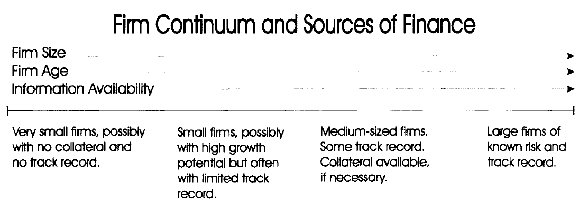
Berger, Allen N. (1998). The Economics of Small Business Finance: The Roles of Private Equity and Debt Markets in the Finance Growth Cycle.
Firms viewed through a financial growth cycle in which different capital structures are optimal at different points in the cycle.
Capital structure varies with age and firm size

Slide 6
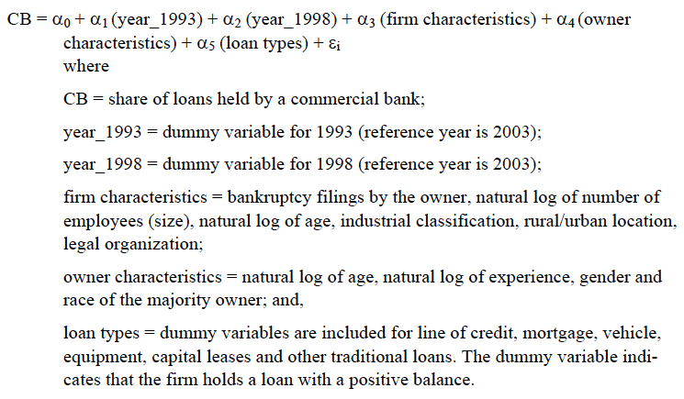
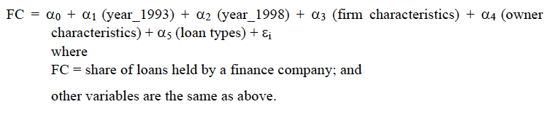
George W. Haynes, James R. Brown,
An Examination of Financial Patterns Using the Survey of Small Business Finances

Slide 7
Data
2003 Survey of Small Business Finances (SSBF)
Collects information on small businesses (fewer than 500 employees) in the United States.
21,200 Observations
Owner characteristics
Firm size
Use of financial services
The income and balance sheets of the firm
http://www.federalreserve.gov/Pubs/oss/oss3/nssbftoc.htm

Slide 8
Conceptual Framework/Model
Linear Regression
Y = β0 + β1X1 + β2X2 + β3X3 +ε
Y = Measure of Small Business Success
  (i.e. Log Sales)
X0 = Intercept
X1 = Credit Variables
X2 = Owner Characteristics
X3 = Firm Characteristics
ε= Error Term

Slide 9
Credit Variables
Checking
Savings
Owner’s Personal Credit Cards
Business Credit Cards
Any Lines of Credit
Mortgage
Motor Vehicle Loans
Equipment Loans
Capital Leases
Other Loans
Trade Credit
Primary Institution
  Commercial Bank
  Savings Bank
  Savings and Loan
  Credit Union
  Finance Company
  Insurance Company
  Brokerage Company

Slide 10
Owner Characteristics
Female
Log Age
Log Experience
Manage
Education
  Less than high school degree
  High school graduate or equivalent (GED)
  Some college but no degree granted
  Associate degree occupational/academic program
  Trade school/vocational program
  College degree (BA, BS, AB, etc.)
  Post graduate degree (MBA,MS,MA,Phd,JD,MD,DDS,etc.)
Hispanic
White
Black
Asian

Slide 11
Firm Characteristics
Log Firm Age
Log Total Employees
Credit Risk
  Dun and Bradstreet Rank Credit Score - 1 most risky; 6 least risky
  1: 0-10
  2: 11-25
  3: 26-50
  4: 51-75
  5: 76-90
  6: 91-100
Bankruptcy
Metropolitan Location
  Urban
  Rural

Slide 12
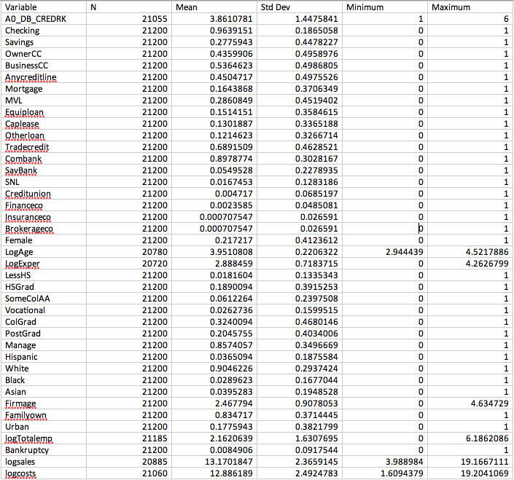

Slide 13
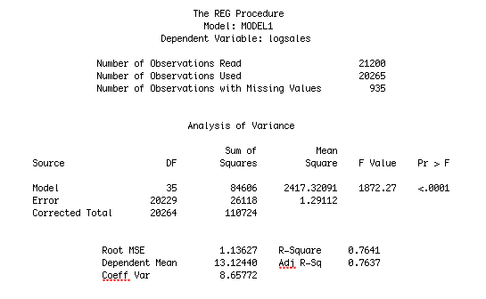

Slide 14
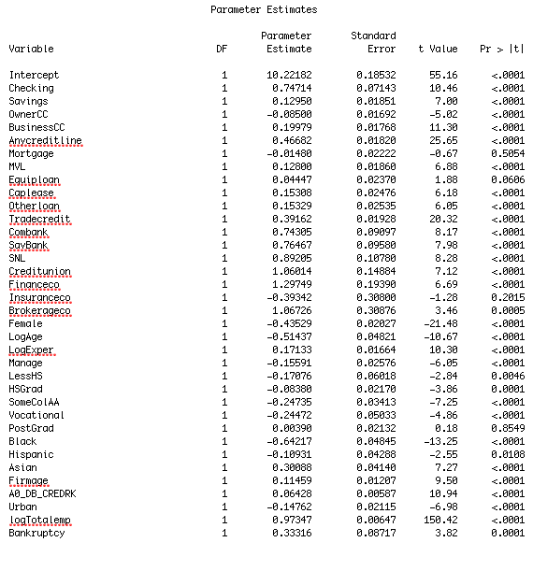

Slide 15
Future Work for Paper
Remove Variables to measure how much each variable of credit effects the R²
Decomposition
  Break Down by Industry
    Account for Seasonal Effects
  Separate by Firm Size
    Account for Business Growth Cycle

Slide 16
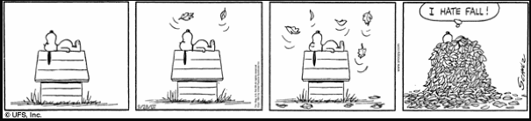
Questions/Comments?

